Slide 1
Project Timeline
Dirk Riehle, Univ. Erlangen
AMOS A03
Licensed under CC BY 4.0 International

Slide 2
Project Goal
To deliver useful software at the end of the project that can be developed further

Slide 3
Scrum in Student Projects
Challenges
Widely differing abilities and experiences
Not 100% on project, but in multiple courses
Transient rather than persistent teams
Not available at same place, not at same time
Sometimes extrinsically motivated (grades)
Solutions
Context-aware instantiation of framework
Supporting teach team, coaching

Slide 4
Additional Roles
Release manager
Holds overall responsibility for reviewable and releasable product
Prepares the product for review in sprint review
Releases the product after agreement
Industry partner
Provides high-level requirements
Provides feedback in defined intervals
See industry guidance at http://bit.ly/2IhUFRn

Slide 5
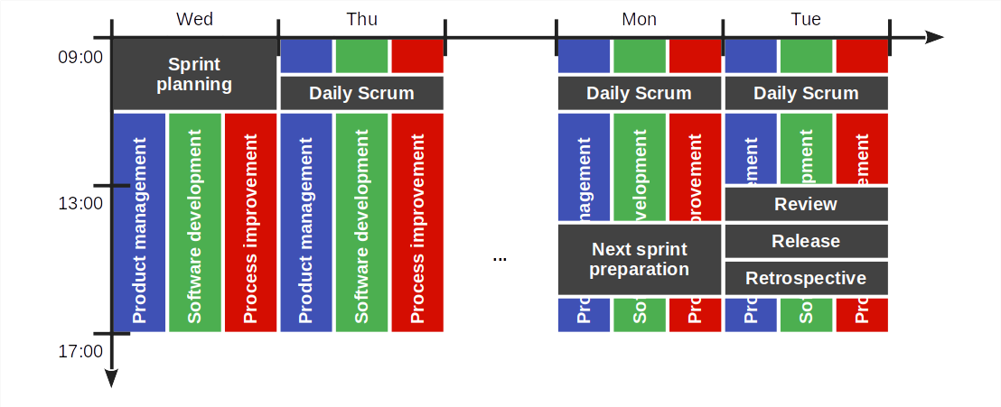
The Sprint Timebox

Slide 6
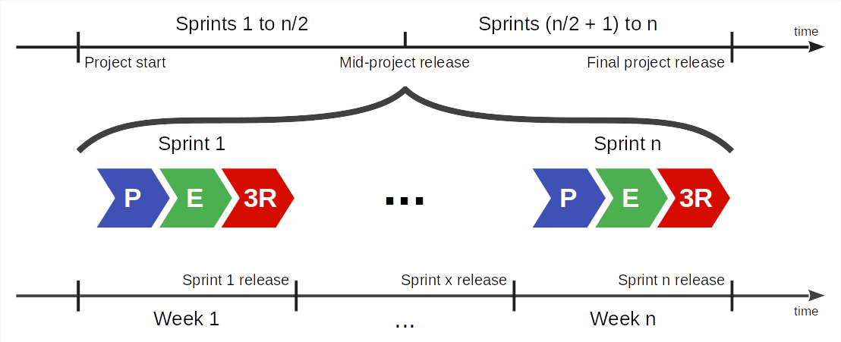
Overall Project Timeline

Slide 7
Time-boxed Sequence of Releases
A release is
A named identifiable, consistent, and useful snapshot of the product
A sprint release is
A release used to gather feedback from the industry partner to steer the project
A project release is
A release that is deployed to production where it is supposed to perform its job
In the AMOS Project there are two releases (mid-project and final release)

Slide 8
Project Schedule
Please see the Schedule tab of the Course Organization doc

Slide 9
Thank you! Any questions?
dirk.riehle@fau.de – https://oss.cs.fau.de
dirk@riehle.org – https://dirkriehle.com – @dirkriehle

Slide 10
Legal Notices
License
Licensed under the CC BY 4.0 International license
Copyright
© Copyright 2023 Dirk Riehle, some rights reserved

